Slide 1

BASIC
Rev A/ August 6, 2013 / Salvador P. Pedeglorio Jr.
TI Selective Disclosure

Slide 2

Training Objectives
At the end of this training the participants must have the fundamental skills required to:
Login and Logout to a UNIX System
Manage Files and Directories
Execute UNIX commands
Manage Processes
Use an editor
Create a simple Bourne Shell Script
Rev A/ August 6, 2013 / Salvador P. Pedeglorio Jr.

Slide 3

Course Outline
Introduction to UNIX
File Management
Directory Management
File / Directory Permission
Environment
Basic Utilities
Processes
Communication
Rev A/ August 6, 2013 / Salvador P. Pedeglorio Jr.

Slide 4
Course Outline (cont..)
Introduction to Bourne Shell Programming
Steps in Creating Bourne Shell Scripts
Variables
Reading User Input
Positional Parameters
Command Substitution
Rev A/ August 6, 2013 / Salvador P. Pedeglorio Jr.

Slide 5
Course Outline (cont..)
Arithmetic
Operators
Conditional Statements
File Testing
Loops
Function
Rev A/ August 6, 2013 / Salvador P. Pedeglorio Jr.

Slide 6
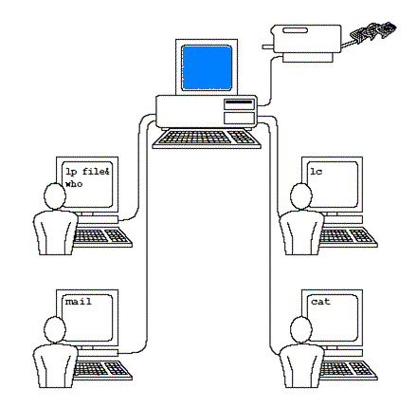
INTRODUCTION
What is UNIX ?
Operating System
Multiuser
Multitasking
UNIX
Rev A/ August 6, 2013 / Salvador P. Pedeglorio Jr.

Slide 7
Original UNIX
Unix was originally developed in 1969 by a group of AT&T employees at Bell Labs, including Ken Thompson, Dennis Ritchie, Brian Kernighan, Douglas Mcllroy, Michael Lesk and Joe Ossanna .
Variants of UNIX
There are various Unix variants available in the market. Solaris Unix, AIX, HP Unix and BSD are few examples. Linux is also a flavor of Unix which is freely available.
Rev A/ August 6, 2013 / Salvador P. Pedeglorio Jr.

Slide 8
UNIX Architecture
Devices attached to the UNIX Computer.
Heart of UNIX
Interface between User and the Kernel.
Tools are the UNIX Commands and Apps are the programs installed or created by the Users.
t\
KERNEL
HARD
WARE
KERNEL
SHELL
TOOLS/APPS
Rev A/ August 6, 2013 / Salvador P. Pedeglorio Jr.
Notes:
Devices attached to the UNIX Computer such as Keyboard, Monitor, Mouse , Printer , etc..
Heart of UNIX , talks to the hardware and devices, schedules tasks, and manages memory and storage
The shell is a utility program that starts up when you log on. It allows users to interact with the kernel by interpreting commands that are typed either at the command line or in a script file.
Tools are the UNIX Commands. Application Programs, such as Word Processors, Spreadsheets and Database Management Systems, may be installed alongside the UNIX Commands. A user may run a utility or application through the shell.

Slide 9
Login to UNIX
Only authorized personnel can be Login on a UNIX Computer. To Login you must have a valid:
USER ID (i.e. a0123456)
PASSWORD
Note:
User ID and Password authentication are case sensitive.
Rev A/ August 6, 2013 / Salvador P. Pedeglorio Jr.

Slide 10
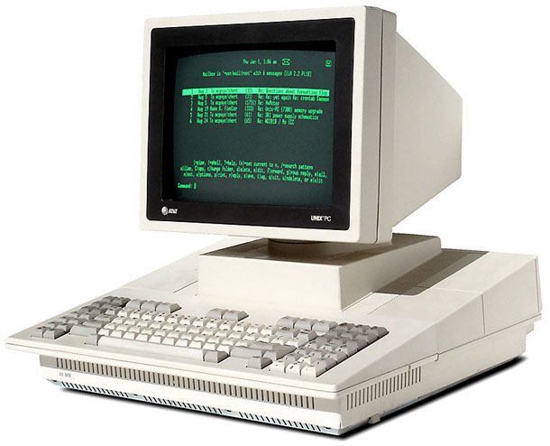
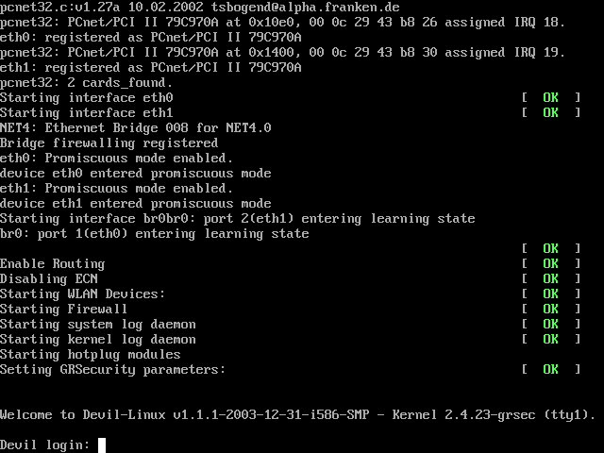
Three ways to Login
System Boot-up Login
Rev A/ August 6, 2013 / Salvador P. Pedeglorio Jr.

Slide 11

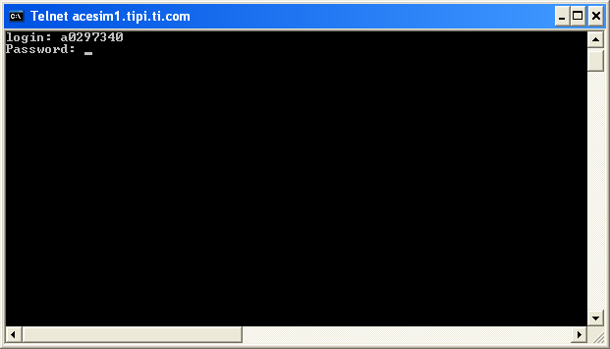
Remote Login
UNIX
UNIX
USE UNIX TERMINAL
USE TERM EMULATORS:
Putty
Poderosa
Rev A/ August 6, 2013 / Salvador P. Pedeglorio Jr.

Slide 12
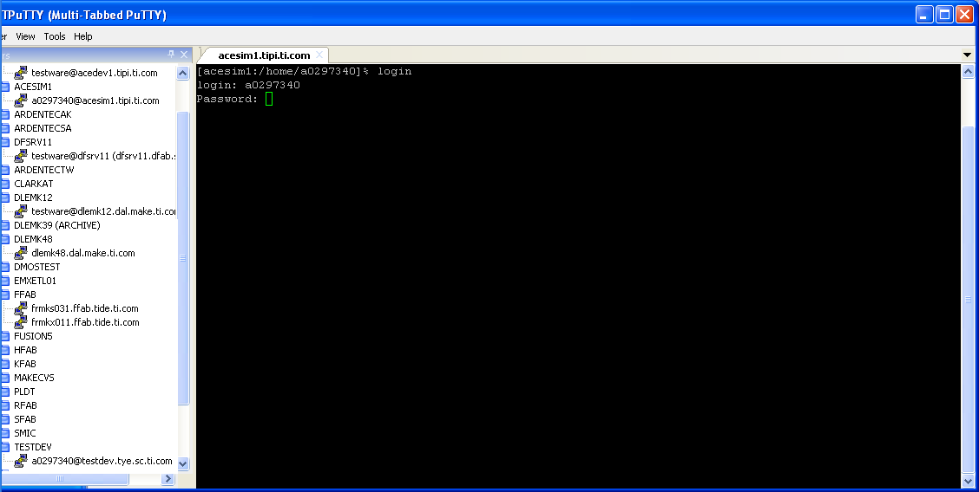
Login using login command
UNIX
UNIX
Rev A/ August 6, 2013 / Salvador P. Pedeglorio Jr.

Slide 13
UNIX COMMANDS
Syntax:
command [-options] [arguments]
Where:
command: name of a UNIX tools/apps to execute.
-options: controls the behavior of the command.
arguments: input data (usually file(s) or strings)
Example:
ls -l /tmp
Note: Some commands doesn’t require options or arguments to work like ps,ls etc..
Rev A/ August 6, 2013 / Salvador P. Pedeglorio Jr.
Notes:
ls is the command to list files. -l option configure the command to display its output in a long format. /tmp is the directory where the command look for files.

Slide 14
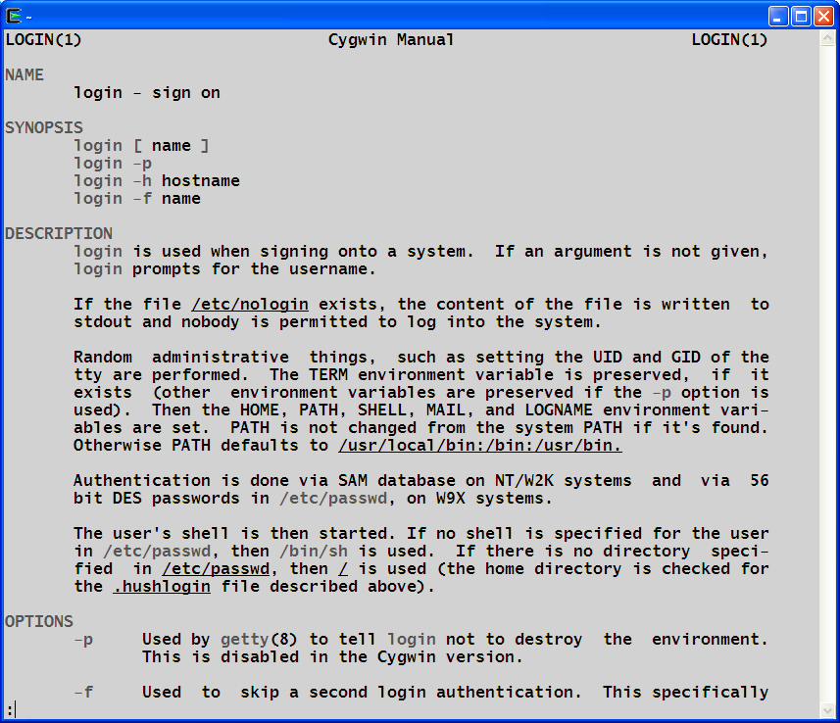
Command Manual
UNIX provides a utility to show information about a command. The syntax, options and examples of the command are documented and accessible to all users.
Syntax:
man [command]
Example:
man login
Rev A/ August 6, 2013 / Salvador P. Pedeglorio Jr.

Slide 15
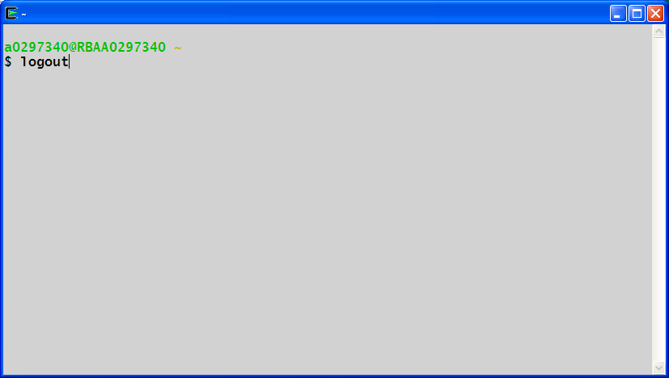
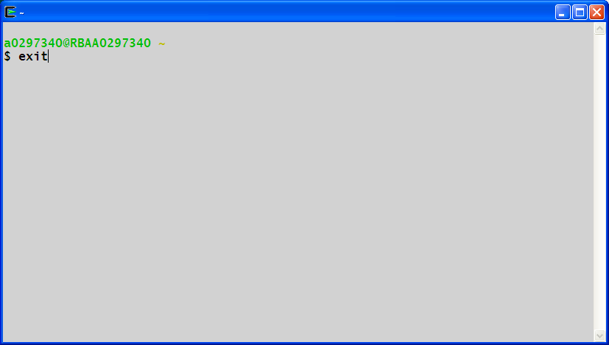
Logging Out
When you finish your session, it is a good practice to logout from the system. Use any of the following command.
logout
or
exit
Rev A/ August 6, 2013 / Salvador P. Pedeglorio Jr.

Slide 16
FILE MANAGEMENT
Basic Types of UNIX Files
Ordinary Files - Contains data, text, or program instructions
Special Files - Provides access to hardware such as hard drives, CD-ROM drives, modems, and Ethernet adapters. Other special files are similar to aliases or shortcuts and enable you to access a single file using different names.
Directories - Stores both special and ordinary files. For users familiar with Windows or Mac OS, UNIX directories are equivalent to folders.
Rev A/ August 6, 2013 / Salvador P. Pedeglorio Jr.

Slide 17












File Structure
DIR
DIR
DIR
DIR
DIR
Rev A/ August 6, 2013 / Salvador P. Pedeglorio Jr.

Slide 18
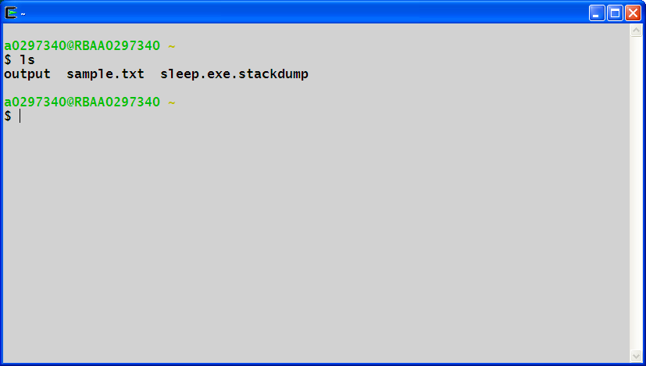
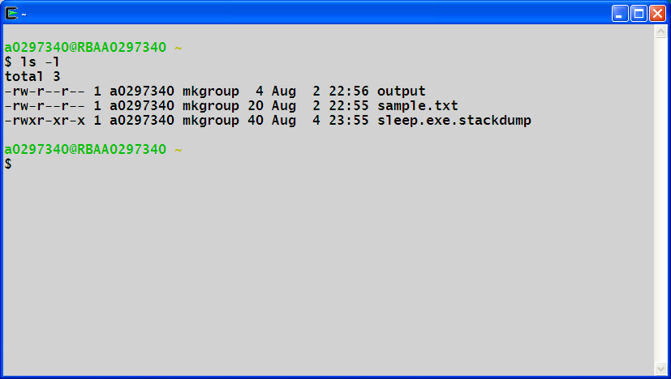

Listing Files
Syntax:
ls [-options] [directory]
Example:
To list all content of the current directory
To list all files in long format
Rev A/ August 6, 2013 / Salvador P. Pedeglorio Jr.

Slide 19
File Information
C
D
E
F
G
A: represents file type and permission
B: represents the number of memory blocks
C: represents owner of the file.
D: represents group of the owner.
E: represents file size in bytes.
F: represents date and time when this file was created
or modified last time.
G: represents file or directory name.
A
B
Rev A/ August 6, 2013 / Salvador P. Pedeglorio Jr.

Slide 20
Files Information (Prefix- Indicator)
- : Regular file, such as an ASCII text file, binary executable, or
hard link.
b : Block special file. Block input/output device file such as a
physical hard drive.
c : Character special file. Raw input/output device file such as a
physical hard drive.
d : Directory file that contains a listing of other files and directories.
l : Symbolic link file. Links on any regular file.
p : Named pipe. A mechanism for interprocess communications
s : Socket used for interprocess communication.
Rev A/ August 6, 2013 / Salvador P. Pedeglorio Jr.

Slide 21
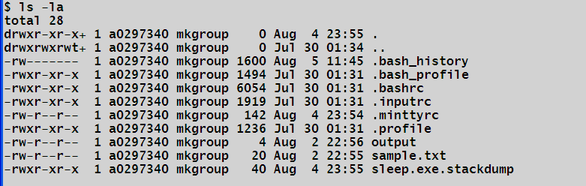
Hidden Files
An invisible file is one whose first character is a dot or period character (.).
To list invisible files add –a option to ls.
Single dot . - This represents current directory.
Double dot .. - This represents parent directory.
Rev A/ August 6, 2013 / Salvador P. Pedeglorio Jr.

Slide 22
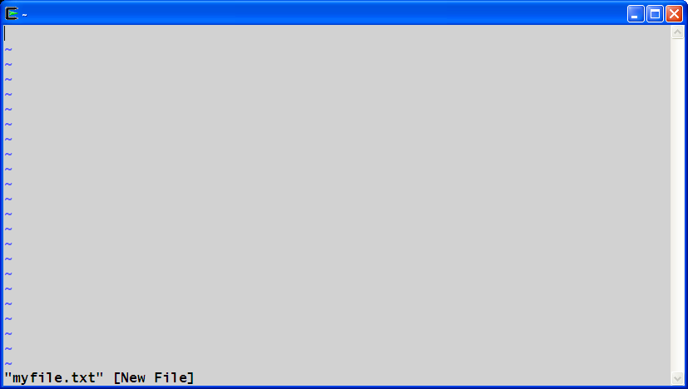
Creating Files
You can create a regular file in many ways. One way is to use the vi editor.
Syntax:
vi <desired filename>
Example:
$vi myfile.txt
Rev A/ August 6, 2013 / Salvador P. Pedeglorio Jr.

Slide 23
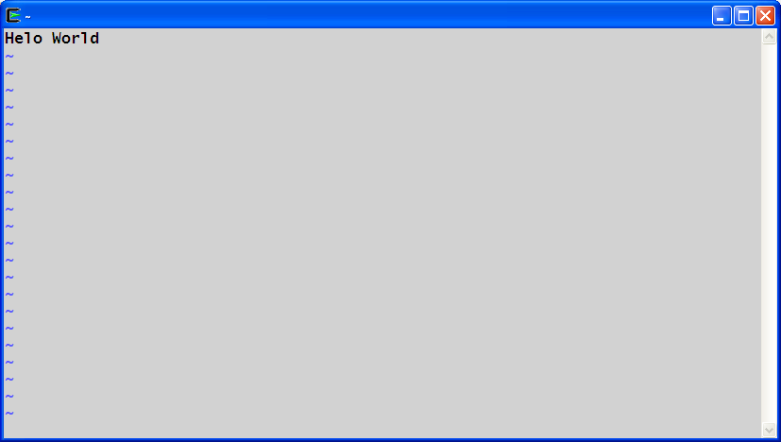
Creating Files
To add content on a file, shift to insert mode by pressing i key then you can now start typing characters on the first line of the file.
Rev A/ August 6, 2013 / Salvador P. Pedeglorio Jr.

Slide 24
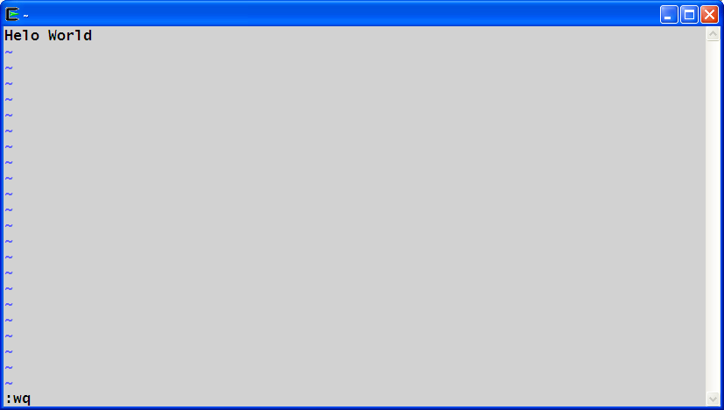
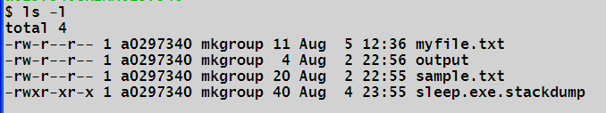
Creating Files
To save the file press esc key then type :wq
Use ls command to check the file
Rev A/ August 6, 2013 / Salvador P. Pedeglorio Jr.

Slide 25
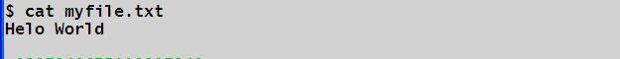
Viewing File Content
Multiple utilities can be use to view the contents of a regular file.
Syntax:
cat [-options] [file(s)]
more [-options] [file]
less [-options] [file]
head [-options] [file]
tail [-options] [file]
vi [file(s)]
Example:
Rev A/ August 6, 2013 / Salvador P. Pedeglorio Jr.

Slide 26
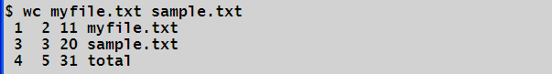
Counting Words on File
You can count the number of words, bytes and line of a files through the use of wc command.
Syntax: wc [-options] [file(s)]
Examples:
File Name
Number of bytes
Number of words
Number of Line
Rev A/ August 6, 2013 / Salvador P. Pedeglorio Jr.

Slide 27
Copying File
To copy a file in the same directory or different locations use the cp command.
Syntax:
cp [-options] [source file] [destination file]
Example:
cp myfile.txt myfile_copy.txt
cp –p myfile.txt /tmp/
cp /tmp/myfile.txt /home/a0297340
Note:
If the destination file exist, it will override the content of the file.
Rev A/ August 6, 2013 / Salvador P. Pedeglorio Jr.

Slide 28
Renaming Files
To change the name of a file use the mv command.
Syntax:
mv [source file] [destination file]
Example:
mv myold_file mynew_file
mv myold_file /tmp/mynew_file
Note:
If the destination file exist, it will override the content of the file.
Rev A/ August 6, 2013 / Salvador P. Pedeglorio Jr.

Slide 29
Deleting Files
To delete a file use the rm command.
Syntax:
rm [file(s)]
Example:
rm mytrash_file
rm mytrash_file mydrafts_file
Note:
If backup system was not in place, there is no way to recover the deleted file(s).
Rev A/ August 6, 2013 / Salvador P. Pedeglorio Jr.

Slide 30
Directory Management
A directory is a file whose sole job is to store file names and related information. In other OS like Windows its commonly called folder.
Root Directory
The root directory of a UNIX file system is always named as / .
Your Home Directory
The directory in which you find yourself when you first login is called your home directory. This is where you create your own files, scripts, etc..
Rev A/ August 6, 2013 / Salvador P. Pedeglorio Jr.

Slide 31
Path Name
Path Name points to a certain location of a file or directory on the file system. It elements are separated by a / character.
Two Type of Path.
Absolute Path : Always begin with / which described its relation to the root directory.
Example:
/home/a0123456
Relative Path : Doesn’t begin with / . It is relative to the current working directory
Example:
myfolder/schedule
Rev A/ August 6, 2013 / Salvador P. Pedeglorio Jr.

Slide 32
Printing Current Directory
To find your current working directory use the pwd command
Syntax:
pwd
Example:
%pwd
/home/a0123456
Rev A/ August 6, 2013 / Salvador P. Pedeglorio Jr.

Slide 33
Changing Directory
You can navigate to a directory using the cd command by providing an absolute or relative path.
Syntax:
cd [destination directory]
Example:
cd /home/a0123456
cd ../home
Note:
You must have a read permission to the destination directory, otherwise it will fail.
Rev A/ August 6, 2013 / Salvador P. Pedeglorio Jr.

Slide 34
Changing Directory (cont..)
You can use the ~ as absolute path to go back to your home directory.
Example:
cd ~
You can also use ~userid to go to other user’s home directory
Example:
cd ~myfriend_id
You can also use – to go back to you previous directory.
Example:
cd -
Notes:
cd - works on Linux only

Slide 35
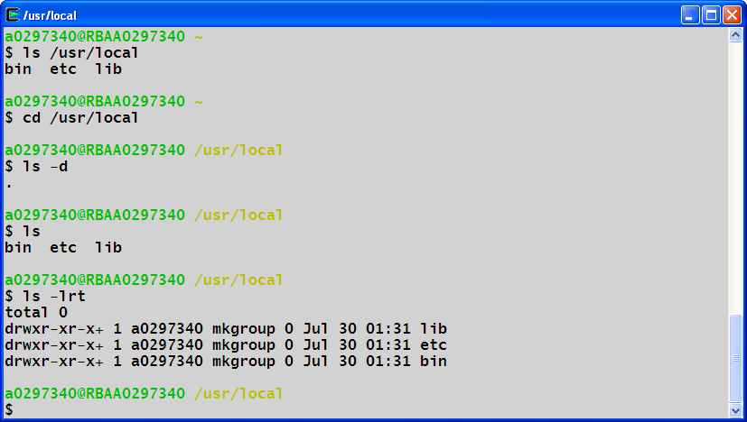
Listing Directory
To list the contents of a directory use the ls command.
Syntax:
ls [directory]
Example:
Rev A/ August 6, 2013 / Salvador P. Pedeglorio Jr.

Slide 36
Creating Directory
To create a directory use the command mkdir.
Syntax :
mkdir [-options] [dirname(s)]
Example:
mkdir junk
mkdir backup /tmp/backup
mkdir –p /tmp/backup/music/pop
Note:
You must have a write permission to the destination or current directory to create, otherwise it will fail.
Rev A/ August 6, 2013 / Salvador P. Pedeglorio Jr.

Slide 37
Removing Directory
To delete an empty directory use the rmdir command.
Syntax:
rmdir [dirname(s)]
Example:
rmdir /tmp/junk
rmdir junk
rmdir emptydir unusedir
Notes:
If Backup system is not in place, there is no way to recover the deleted directories.
Rev A/ August 6, 2013 / Salvador P. Pedeglorio Jr.
Notes:
rm –r

Slide 38
Removing Directory
To delete a non-empty directory use the rm with -r command.
Syntax:
rm -r [dirname(s)]
Example:
rm -r /tmp/junk
rm -r junk
rm -r dir unusedir
Notes:
If Backup system is not in place, there is no way to recover the deleted directories.
Rev A/ August 6, 2013 / Salvador P. Pedeglorio Jr.
Notes:
rm –r

Slide 39
Renaming Directory
To rename directory use the command mv.
Syntax:
mv [source dirname] [destination dirname]
Example:
mv mydir yourdir
mv myjunk /tmp/myjunk_copy
Note:
You must have a write permission to the source directory to move, otherwise it will fail.
Rev A/ August 6, 2013 / Salvador P. Pedeglorio Jr.

Slide 40
File Permission/Access Mode
File Permission Attributes:
Owner Permission - Determines what actions the owner of the file can perform on the file.
Group Permission - Determines what actions a user, who is a member of the group that a file belongs to, can perform on the file.
Others Permission - Determines what action all other users can perform on the file.
Rev A/ August 6, 2013 / Salvador P. Pedeglorio Jr.

Slide 41
File Permission Indicator
File Permission Indicator are set into 3 types of users.
U – Owner of the file
G – Group where the file belong.
O - Everyone who have access to the system.
U
G
O
Rev A/ August 6, 2013 / Salvador P. Pedeglorio Jr.

Slide 42
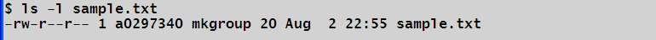
Access Mode
Each permissions have 3 character positions which denotes access modes:
Read ( r ) - Grants the capability to read ie. view the contents of the file.
Write ( w ) - Grants the capability to modify, or remove the content of the file.
Execute ( x ) - User with execute permissions can run a file as a program.
Denied ( - ) - Denied access
Example:
The owner of the file have the read and write access while group and other has read-only access .
Rev A/ August 6, 2013 / Salvador P. Pedeglorio Jr.

Slide 43
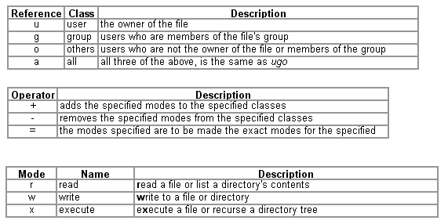
Changing Permission
To change permission of a file use the chmod command.
Syntax:
chmod [-options] [reference[operator]mode(s)] [file(s)]
Where:
Rev A/ August 6, 2013 / Salvador P. Pedeglorio Jr.
Notes:
OCTAL MODE For File Permission
4 stands for "read",
2 stands for "write",
1 stands for "execute", and
0 stands for "no permission."

Slide 44
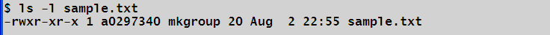
Changing Permission (cont..)
Example:
To Add execute permission to all user in file sample.txt.
Before:
chmod a+x sample.txt or
chmod +x sample.txt or
chmod ugo+x sample.txt
After:
Rev A/ August 6, 2013 / Salvador P. Pedeglorio Jr.

Slide 45
Environments
Shell Initialization
When you login to the system, the shell undergoes a phase called initialization to set up various environment. This is usually a two step process that involves the shell reading the following files:
/etc/profile ( set by system admin)
profile (set by user)
Each file can contain portion to setup an environments variable(s). This variables controls some behavior of your shell terminal.
Rev A/ August 6, 2013 / Salvador P. Pedeglorio Jr.

Slide 46
Environmental Variables
Variable is a memory segment which is used to store data.
To set an Environmental Variable in (Bourne Shell):
Syntax: VARNAME=“value”
Example: NAME=“Mang Juan”
To display the value assigned to a Variable use the echo command:
Syntax: echo $[VARNAME]
Example:
echo $NAME
Mang Juan
Rev A/ August 6, 2013 / Salvador P. Pedeglorio Jr.

Slide 47
Setting the Path:
When you type any command on command prompt, the shell has to locate the command before it can be executed.
The PATH variable specifies the locations in which the shell should look for commands. Usually it is set as follows:
PATH=/bin:/usr/bin
Rev A/ August 6, 2013 / Salvador P. Pedeglorio Jr.

Slide 48
Setting up Shell Prompts
PS1=“%” change your shell primary prompt to %
PS2=“%%” change your shell secondary prompt to %%
PS1=“[\w]” change your shell prompt to [current directory]
Escape Sequence | Description
\t | Current time, expressed as HH:MM:SS.
\d | Current date, expressed as Weekday Month Date
\n | Newline.
\s | Current shell environment.
\W | Working directory.
\w | Full path of the working directory.
\u | Current user.s username.
\h | Hostname of the current machine.
\# | Command number of the current command. Increases with each new command entered.
\$ | If the effective UID is 0 (that is, if you are logged in as root), end the prompt with the # character; otherwise, use the $.
Rev A/ August 6, 2013 / Salvador P. Pedeglorio Jr.

Slide 49
Metacharacters
Characters that has a special meaning (instead of a literal meaning) to a UNIX shell such as Bourne Shell.
Rev A/ August 6, 2013 / Salvador P. Pedeglorio Jr.
Symbol | Meaning
> | Output redirection
>> | Output redirection (append)
< | Input redirection
* | File substitution wildcard; zero or more characters
? | File substitution wildcard; one character
[ ] | File substitution wildcard; any character between brackets
`cmd` | Command Substitution
$(cmd) | Command Substitution
| | The Pipe (|)
; | Command sequence, Sequences of Commands
|| | OR conditional execution
&& | AND conditional execution
( ) | Group commands, Sequences of Commands
& | Run command in the background, Background Process
# | Comment
$ | Expand the value of a variable
\ | Prevent or escape interpretation of the next character
<< | Input redirection

Slide 50
Metacharacters (cont…)
To redirect the output of a command to a file ( > )
echo Good Morning! > greetings
To append the output of a command to a file ( >>)
echo Bad Afternoon! >> greetings
To redirect a file content to a command ( < )
wc –l < greetings
To redirect a multiple line of input to a command <<
wc –l << TAG
line 1
line 2
TAG
Rev A/ August 6, 2013 / Salvador P. Pedeglorio Jr.
Notes:
If you use > to redirect output to a file a new file will always be created:
- replace the current content if it exists. Using >> to redirect output to a file will only create a new file if the file doesn't exist, if the file exists then the output will be appended to the end of the file.

Slide 51
Metacharacters (cont…)
To use the output of a command as input of another command ( | )
ls –l | wc –l
To run a sequence of command on one line ( ; )
echo Changing Directory to tmp; cd /tmp ; pwd
To assign the output of command to a variable ( ` ` )
TIME=`date`
To remove all files with extension .txt from the current working directory ( * )
rm *.txt
Rev A/ August 6, 2013 / Salvador P. Pedeglorio Jr.

Slide 52
Metacharacters (cont…)
To list all files with name start with a vowel ( [ ] )
ls [aeiou]*
Represent a single character ( ? )
ls –l “b?y”
To display the value of variable ( $ )
echo $PATH
Rev A/ August 6, 2013 / Salvador P. Pedeglorio Jr.

Slide 53
BASIC UTILITIES
Rev A/ August 6, 2013 / Salvador P. Pedeglorio Jr.

Slide 54
grep
The grep command searches a file or files for lines that have a certain pattern.
Basic Syntax:
grep pattern file(s)
To search for a given string in a file
grep “string” file
To search for a given string in a files
grep “string” file1 file2 …filen
Case insensitive search
grep -i “string” file
To search for exact word
grep –w “word” file
Rev A/ August 6, 2013 / Salvador P. Pedeglorio Jr.

Slide 55
grep (cont…)
Invert match
grep –v “pattern” file
Count the number of lines matches the pattern
grep –c “pattern” file
Display the file names which matches the pattern
grep –l “pattern” file(s)
Show the line number
grep –n “pattern” file(s)
Rev A/ August 6, 2013 / Salvador P. Pedeglorio Jr.

Slide 56
Using RE on grep
Match at the beginning of line ( ^ )
grep “^pattern” file
Match at the end of line ( $ )
grep “patern$” file
Match empty line ( ^$ )
grep “^$” file
Match Single Character ( . )
grep “.” file
Match zero or more occurrence ( * )
grep “*” file
Rev A/ August 6, 2013 / Salvador P. Pedeglorio Jr.

Slide 57
Using RE on grep (cont…)
Match one or more occurrence ( \+ )
grep “its \+okay” file
Match Zero or one occurrence ( \?)
grep “its \?okay” file
Match special character (\)
grep “192\.168\.0\.1” file
Match character class ( [0-9] )
grep [12345] file
grep [0-9] file
grep [a-z] file
grep [A-Z]
Rev A/ August 6, 2013 / Salvador P. Pedeglorio Jr.

Slide 58
Using RE on grep (cont…)
Exception in the class [^0-9]
grep “[^aeiou]” file
OR Operation ( \| )
grep “good\|accept” file
M to N Occurrence ({m,n})
grep “[0-9]\{1,5\}” file
Exact M occurrence
grep “[0-9]\{5\}” file
M or more occurrence
grep “[0-9]\{5,\}” file
Rev A/ August 6, 2013 / Salvador P. Pedeglorio Jr.

Slide 59
find
The find command is used to locate file(s) on the UNIX system.
To search files using name in the current and sub directories.
find –name “greetings”
To search files using name in case insensitive
find –iname “Greetings”
To invert the match
find –not –name “greetings”
To find a file based on permission
find . –perm a=rwx
Rev A/ August 6, 2013 / Salvador P. Pedeglorio Jr.

Slide 60
find (cont …)
To find empty files
find . –empty
To find files using file type
find . –type f
find . –type d
find . –type s
find . –type l
To find files by size
find . –size +100c
find . –size -100c
find . –size 100c
Rev A/ August 6, 2013 / Salvador P. Pedeglorio Jr.
Notes:
find . –empty

Slide 61
find ( cont ..)
To delete the files returned by the find
find ~ -empty –type f –exec rm –f {} \ ;
To find files modified 1 hour ago
find ~ -mtime -1
find ~ -mmin -60
To find files accessed within last hour
find –amin -60
find –atime -1
Rev A/ August 6, 2013 / Salvador P. Pedeglorio Jr.

Slide 62
sed
The sed command is a stream editor for filtering and transporting text.
To print line 3 of a file:
sed –n ‘3’p file
To print every other next line starting from line 3
sed -n ‘3,$’p file
To print a range of line starting from line 3
sed –n ‘3,5’p file
sed -n ‘3,$’p file
Rev A/ August 6, 2013 / Salvador P. Pedeglorio Jr.

Slide 63
sed ( cont .. )
To print the line(s) containing a pattern apple:
sed –n /apple/p file
To print line(s) starting from line containing the patter apple till the 3rd line
sed -n ‘/apple/,3p’ file
To print the line(s) starting from a line containing the pattern apple plus next 2 lines:
sed -n ‘/apple/,+2p’ file
To print the section of the file starting from a line containing the pattern apple then ends with the line containing patter orange :
sed -n ‘/apple/,/orange/p’ file

Slide 64
sed ( cont .. )
To delete line 1 on a file
sed ‘1d’ file
To delete starting from line 1 then every other 2 line:
sed ‘1~2d’ file
To delete line starting from line 2 to 3:
sed ‘2,3d’ file
To delete the last line of the file
sed ‘$d’ file
To delete the line(s) containing the pattern apple
sed ‘/apple/d’ file
Rev A/ August 6, 2013 / Salvador P. Pedeglorio Jr.

Slide 65
sed ( cont .. )
To delete line(s) starting from the line containing the patter apple till the end of file:
sed ‘/apple/,$d’ file
To delete line(s) starting from line containing pattern apple plus 2 lines:
sed ‘/apple/+2d’ file
To delete all blank line
sed ‘/^$/d’ file
To substitute the word apple to red on a file:
sed ‘s/apple/red/’ file
To substitute all appearance of the letter ‘a’ to A
sed ‘s/a/A/g/’ file
Rev A/ August 6, 2013 / Salvador P. Pedeglorio Jr.

Slide 66
Sending Email
Use the mail utility to send email.
Syntax:
$mail [-s subject] [-c cc-addr] [-b bcc-addr] to-addr
Example:
mail –s “Testing” mymail@ti.com
You are then expected to type in your message. To stop simply type dot (.) as follows:
Hi,
This is a test .
Cc:
Rev A/ August 6, 2013 / Salvador P. Pedeglorio Jr.

Slide 67
Task Scheduling:
Use the crontab command to schedule a task/program to run at specified time frame.
Syntax:
* * * * * command(s)
| | | | |
| | | | +---day of week (0 - 7) (Sunday=0 or 7)
| | | +-------month (1 - 12)
| | +-----------day of month (1 - 31)
| +----------------hour (0 - 23)
+--------------------min (0 - 59)
Example:
* * * * * (echo `date` >> timestamp.txt)
Rev A/ August 6, 2013 / Salvador P. Pedeglorio Jr.

Slide 68
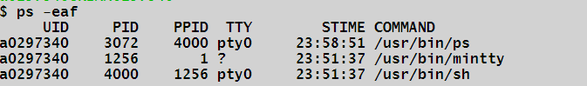
Processes
To start a process in foreground
sleep 10
To start a process in background
sleep 10 &
To list running processes:
ps
To list running processes with more information
ps –eaf
Rev A/ August 6, 2013 / Salvador P. Pedeglorio Jr.

Slide 69
Process Information
Column | Description
UID | User ID that this process belongs to (the person running it).
PID | Process ID.
PPID | Parent process ID (the ID of the process that started it).
C | CPU utilization of process.
STIME | Process start time.
TTY | Terminal type associated with the process
TIME | CPU time taken by the process.
CMD | The command that started this process.
Rev A/ August 6, 2013 / Salvador P. Pedeglorio Jr.

Slide 70
Stopping Processes
To kill the process mintty
kill 1256
or kill -9 1256
To check the top running processes
top
Rev A/ August 6, 2013 / Salvador P. Pedeglorio Jr.

Slide 71
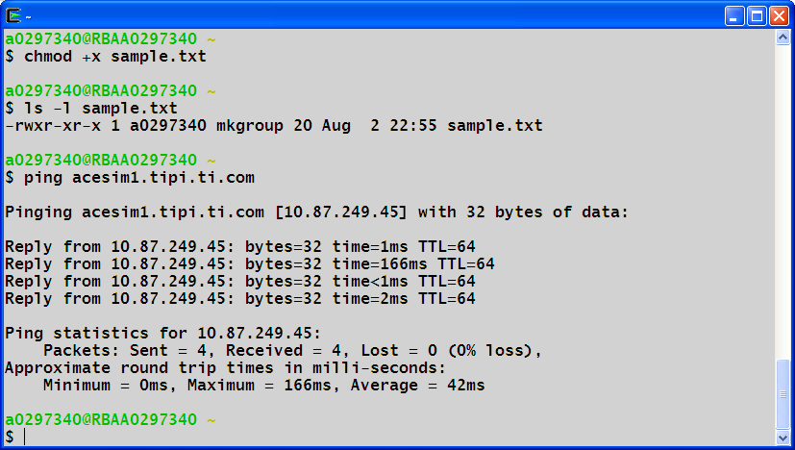
Communication
The ping utility
Sends an echo request to a host available on the network. Using this command you can check if your remote host is responding well or not
Syntax:
ping hostname or ip address
Example:
Rev A/ August 6, 2013 / Salvador P. Pedeglorio Jr.

Slide 72
The ftp utility
Helps you to upload and download your file from one computer to another computer.
Syntax:
ftp [options] hostname
Command | Description
put filename | Upload filename from local machine to remote machine.
get filename | Download filename from remote machine to local machine.
mput file list | Upload more than one files from local machine to remove machine.
mget file list | Download more than one files from remote machine to local machine.
prompt off | Turns prompt off, by default you would be prompted to upload or download movies using mput or mget commands.
prompt on | Turns prompt on.
dir | List all the files available in the current directory of remote machine.
cd dirname | Change directory to dirname on remote machine.
lcd dirname | Change directory to dirname on local machine.
quit | Logout from the current login.
Rev A/ August 6, 2013 / Salvador P. Pedeglorio Jr.

Slide 73
Remote connection
To connect on server1 using telnet
telnet server1
To connect using rsh
rsh server1
To connect using ssh
ssh server1
Rev A/ August 6, 2013 / Salvador P. Pedeglorio Jr.

Slide 74
Basic Bourne Shell Scripting
Rev A/ August 6, 2013 / Salvador P. Pedeglorio Jr.

Slide 75
Introduction
Interactive Shell
Shell Scripting
Rev A/ August 6, 2013 / Salvador P. Pedeglorio Jr.

Slide 76
Steps in Creating a Shell Script
1. The First Line – indicate the corresponding shell to use in executing the instructions written on your script. This is knows as “shbang” with the form:
Format:
#!<shell directory path>
Examples:
for bourne shell, 1st line is : #!/bin/sh
for c shell, 1st line is : #!/bin/csh
for korn shell, 1st line is : #!/bin/ksh
Rev A/ August 6, 2013 / Salvador P. Pedeglorio Jr.

Slide 77
Steps in Creating a Shell Script
2. Adding Comments - lines preceded with the pound sign (#). This is use to document your script, it is ignored by the shell.
Example:
#!/bin/sh
#this is my first bourne shell script
3. Writing your instructions - commands and bourne shell constructs.
Example:
#!/bin/sh
#This is my first bourne program
echo “Hello World
Rev A/ August 6, 2013 / Salvador P. Pedeglorio Jr.
Notes:
Explanation:
The 1st line assigned the bourne shell as the interpreter of the commands or instruction on the script.
The 2nd line is a comment since its started with the # sign followed by the programmer message. This will be ignore by the shell.

Slide 78
Steps in Creating a Shell Script
4. Making the script executable – When you save your program it is not given the execute permission. In order to make your program executable you need to grant the execute permission.
Example:
%chmod +x myprog.sh
%ls –lrt myprog.sh
-rwxr-xr-x 1 a0297340 testware 0 Apr 6 12:55 myprog.sh
Rev A/ August 6, 2013 / Salvador P. Pedeglorio Jr.
Notes:
Explanation:
chmod command add the permission x=execute to all users in myprog.sh script
ls –lrt command list the myprog.sh file attributes showing

Slide 79
Steps in Creating a Shell Script
5. Testing your script - run the script through a command line to check if all functionalities are working as expected.
To execute using absolute program path:
/home/a0297340/sample/myprogram.sh
To execute using relative path (on the current program directory):
./myprog.sh
Running anywhere with program name (program absolute directory should exist on PATH)
myprog.sh
Rev A/ August 6, 2013 / Salvador P. Pedeglorio Jr.

Slide 80
Steps in Creating a Shell Script
6. Debugging your script – Wrong syntax, badly formed constructs or erroneous instructions may lead to unwanted output, unexpected behavior and unrecoverable crash of the program or worst case server fatal shutdown.
To check for a syntax error on your script:
sh – n myprog.sh
./myprog.sh: line 3: unexpected EOF while looking for matching `"'
./myprog.sh: line 4: syntax error: unexpected end of file
Rev A/ August 6, 2013 / Salvador P. Pedeglorio Jr.
Notes:
Explanation:
After executing the script it return two lines of error detailing the problem found while running the program.

Slide 81
Variables
Local variables – are variables accessible on the current scope where they are declared. They are set by the following form
Syntax:
variablename=value
Example:
name=“Juan Dela Cruz”
age=“28”
Rev A/ August 6, 2013 / Salvador P. Pedeglorio Jr.

Slide 82
Variables ( cont .. )
Global variables – known also as environmental variables. They are normally declared using uppercase letters. They are accessible on the current shell and and any process spawned from that shell.
Syntax:
PATH=value
export PATH
Example:
PATH=/bin:/usr/bin/:/salvador/home
export PATH
Rev A/ August 6, 2013 / Salvador P. Pedeglorio Jr.

Slide 83
Variables ( cont .. )
Variable Substitution – to extract the values assigned in a variable a dollar sign is used.
Example:
myname=“Salvador Pedeglorio”
echo “my name is $myname”
my name is Salvador Pedeglorio
Rev A/ August 6, 2013 / Salvador P. Pedeglorio Jr.
Notes:
Explanation:
Line 1 assigned the string “Salvador Pedeglorio” to the variable myname.
Line 2 execute the echo command to print the the string “my name is $myname”, the variable myname is also substituted to it assigned value (Salvador Pedeglorio)
Line 3 prints the output on the stdout .

Slide 84
Reading User Input
The read command is used to get the user input in the stdin channel.
Syntax:
read <variablename>
Example:
echo “What is your name?”
read name
echo “User is $name”
Notes:
Line 1 prints a question to the stdout.
Line 2 waits for the input from the stdin
Line 3 prints the string “User is <inputs>”

Slide 85
Arguments
Positional Parameters – are used to receive the arguments passed to the script.
Example:
scriptname arg1 arg2 arg3
Inside the script:
$1 is equal to arg1
$2 is equal to arg2
$3 is equal to arg3
$* is equal to all args
$# is equal to count of args
Rev A/ August 6, 2013 / Salvador P. Pedeglorio Jr.

Slide 86
Command Substitution
To assign the output of a UNIX/Linux command to a variable or use its output in a string, backquotes ( ` ` ) character are used.
Syntax:
variable_name=`command`
echo $variable_name
Example:
computer_processor=`uname –p`
echo $computer_processor
echo “Computer Processor is `uname –p`”
Rev A/ August 6, 2013 / Salvador P. Pedeglorio Jr.
Notes:
Explanation:
Line 1 assigned the output of unix command uname into the computer_processor variable
Line 2 prints the value of the computer _processor
Line 3 prints the output of the uname command concatenated to a given string

Slide 87
Arithmetic
Integer Calculation – to perform integer calculation the expr unix command is commonly used in Bourne Shell scripts. The +,-,*,/ and % operators are supported and the normal programming precedence applied.
Example:
Command Output
expr 1 + 9 10
expr 10-1 10-1
expr 7 + 9 / 3 10
expr 3 * 3 error
expr 3 \* 3 9

Slide 88
Arithmetic ( cont .. )
Floating Point Calculation – to perform precision calculation on Bourne Shell the bc, awk and nawk utilities are used.
Examples:
echo “scale=2; 9 / 4” | bc
>2.25
awk -v x=9 -v y=4 'BEGIN{printf "%.4f\n",x/y}‘
>2.2500
Rev A/ August 6, 2013 / Salvador P. Pedeglorio Jr.

Slide 89
Expressions
A combination of explicit values, constants, variables, functions that are interpreted according to the particular rules of precedence.
Examples:
$y –eq 1
`expr 10 + 12` -ne 22
Rev A/ August 6, 2013 / Salvador P. Pedeglorio Jr.

Slide 90
Expressions ( cont .. )
To evaluate an expression the test built-in test command is used or the expression can be enclosed by square brackets.
Example:
test apple = mansanas
test 5 > 10
or
[ apple = mansanas ]
[ 5 > 10 ]

Slide 91
Expressions ( cont .. )
String Testing
Example:
test -n $word or [ -n $word ]
test tom = sue or [ tom = sue ]
Expression | Description
string1 = string2 | String1 is equal to String2 (space surrounding = required)
string1 != string2 | String1 is not equal to String2 (space surrounding != required)
string | String is not null
–z string | Length of string is zero
–n string | Length of string is nonzero
Rev A/ August 6, 2013 / Salvador P. Pedeglorio Jr.

Slide 92
Expressions ( cont .. )
Integer Test
Example:
[ 1 –eq 10 ]
test 50 –ne 5
Expression | Description
int1 –eq int2 | Int1 is equal to int2
int1 –ne int2 | Int1 is not equal to int2
int1 –gt int2 | Int1 is greater than int2
int1 –ge int2 | Int1 is greater than or equal to int2
int1 –lt int2 | Int1 is less than int2
int1 –le int2 | Int1 is less than or equal to int2
Rev A/ August 6, 2013 / Salvador P. Pedeglorio Jr.

Slide 93
Expressions ( cont .. )
Logical Test
Example:
a=10
[ $a –lt 10 –o $a –eq 10 ]
Expression | Description
expr1 -a expr2 | Logical AND
expr1 -o expr2 | Logical OR
! expr | Logical NOT
Rev A/ August 6, 2013 / Salvador P. Pedeglorio Jr.

Slide 94
Expressions ( cont .. )
File Test
Expressions | Description
–b filename | Block special file
–c filename | Character special file
–d filename | Directory existence
–f filename | Regular file existence and not a directory
–g filename | Set-group-ID is set
–k filename | Sticky bit is set
–p filename | File is a named pipe
–r filename | File is readable
–s filename | File is nonzero size
–u filename | Set-user-ID bit is set
–w filename | File is writable
–x filename | File is executable
Rev A/ August 6, 2013 / Salvador P. Pedeglorio Jr.

Slide 95
Expressions ( cont .. )
Exit status - The exit status of the evaluation is true(0) or false(1) and will be stored on the ? variable.
Example:
Commands Output
[ z = Z ] 1
test –z “” 0
Rev A/ August 6, 2013 / Salvador P. Pedeglorio Jr.

Slide 96
Conditional Constructs
Rev A/ August 6, 2013 / Salvador P. Pedeglorio Jr.

Slide 97
If/else
Syntax
Example
if expression
then
commands
else
commands
fi
if [ `date ‘+ %Y’` -eq 2013 ]
then
echo “The Year is 2013”
else
echo “The Year is not 2013”
fi
Rev A/ August 6, 2013 / Salvador P. Pedeglorio Jr.

Slide 98
if/elif/else
Syntax
Example
if expression
then
command(s)
elif expression
then
commands(s)
elif expression
then
command(s)
else
command(s)
fi
if [ $x –eq 1 ]
then
echo “Ready”
elif [ $x –eq 2 ]
then
echo “Get Set”
elif [ $x –eq 3 ]
then
echo “Go”
else
echo “Stop”
fi
Rev A/ August 6, 2013 / Salvador P. Pedeglorio Jr.

Slide 99
Case
Syntax
Examples
case variable in
value1)
command(s)
;;
value2)
command(s)
;;
value3)
command(s)
;;
esac
case $x in
1)
echo “Ready”
;;
2)
echo “Get Set”
;;
echo “Go”
;;
esac
Rev A/ August 6, 2013 / Salvador P. Pedeglorio Jr.

Slide 100
for
Syntax
Example
for variable in word_list
do
command(s)
done
for num in 1 2 3 4 5
do
echo “iteration:$num”
done
Rev A/ August 6, 2013 / Salvador P. Pedeglorio Jr.

Slide 101
while
Syntax
Example
while
expressions
do
command(s)
done
a= 0
while [ $a -lt 11 ]
do
echo “10 x $a = `expr 10 \* $a`”
a=`expr $a + 1`
done
Rev A/ August 6, 2013 / Salvador P. Pedeglorio Jr.

Slide 102
Function
Syntax
Example
function_name () {
commands
}
add () {
sum=`expr $1 + $2`
return $sum
}
Rev A/ August 6, 2013 / Salvador P. Pedeglorio Jr.

Slide 103
Function
dot(.) – function can be stored on a file then can be called when needed.
Syntax:
. <file path>
Example:
To integrate the functions from file inside the script
. /home/a0297340/myfunctions
Rev A/ August 6, 2013 / Salvador P. Pedeglorio Jr.

Slide 104
Revision History
Rev | Rev Date | Revised By | Revision Items
A | 08/06/13 | Salvador P. Pedeglorio | Original Version
Rev A/ August 6, 2013 / Salvador P. Pedeglorio Jr.

